Slide 1
InfoPath 2010 and Forms Services
Notes:
Finally, you can make your goals of going paperless a reality! Microsoft Office InfoPath 2010 and SharePoint Server 2010 together provide a powerful platform for working with electronic forms. In this module, you will see how you can build robust electronic forms with data validation and conditional logic using InfoPath 2010 and then publish them easily to SharePoint Server 2010 to be filled out by the users using just an internet browser.

Slide 2
Agenda
Introducing InfoPath 2010
Form Designer Development Tools
Incorporating Form Logic
SharePoint List Forms
Form Library Forms
Data Connections to External Sources
Publishing Options

Slide 3

What is InfoPath?
Forms for SharePoint
Lists, External Lists, Form Libraries & Workflow forms
Forms integrated into Office
SharePoint Workspace, Outlook, Word, PowerPoint, Excel
Browser and Client forms with form logic & data connectivity
Form Designer & Filler
Notes:
Microsoft InfoPath 2010 is a powerful electronic form generation tool. InfoPath 2010 is the third iteration of this software, the first one coming out in 2003 (InfoPath 2003). InfoPath uses an XML format to standardize your form information. Because it follows a standard, it’s easy to write computer programs to interact with the form data to control the business process. In fact, InfoPath can often control the entire business process itself.
InfoPath 2010 is deeply integrated in designing list and library forms for SharePoint 2010. In addition to designing SharePoint list and library forms, you can design InfoPath form templates that can be published and hosted in a Form Library within SharePoint. Later in this slide deck the differences between the two are compared.

Slide 4
The Power of InfoPath
Browser and Client forms
Form Designer & Filler
Visual Layout
Form Logic
Data Connection
Notes:
InfoPath 2010 is actually a set of two applications:
InfoPath Designer: The tool that’s necessary to create/design forms.
InfoPath Filler: The tool for users to fill in the pre-designed forms (if you are running Forms Services then forms can be filled using the browser as well).
InfoPath gives the non-developer user a lot of power with a minimal amount of effort. The layout of forms is created using tables to align the labels and controls in the form. An extensive collection of controls (text boxes, drop-down lists, checkboxes etc) is available at the form creator’s disposal. Form designers can easily and quickly configure form logic by clicking around in the interface. Data connections can be created also to a variety of data sources. And best of all… none of this requires any coding at all. These concepts are further discussed in later slides.

Slide 5


InfoPath & Forms Services
Ribbon UI
SharePoint Workspace
SharePoint Mobile
Office Client and Office Web App Integration
Standards Support
Business Connectivity Services
InfoPath Form Services
External Lists
Workflow
SharePoint Designer
Visual Studio
API Enhancements
REST/ATOM/RSS
Tagging, Tag Cloud, Ratings
Social Bookmarking
Blogs and Wikis
My Sites
Activity Feeds
Profiles and Expertise
Org Browser
Sites
Composites
Communities
PerformancePoint Services
Excel Services
Chart Web Part
Visio Services
Web Analytics
SQL Server Integration
PowerPivot
Insights
Content
Enterprise Content Types
Metadata and Navigation
Document Sets
Multi-stage Disposition
Audio and Video Content Types
Remote Blob Storage
List Enhancements
Search
Social Relevance
Phonetic Search
Navigation
FAST Integration
Enhanced Pipeline
Notes:
InfoPath and Forms Services fall into the Composites workload of SharePoint.

Slide 6
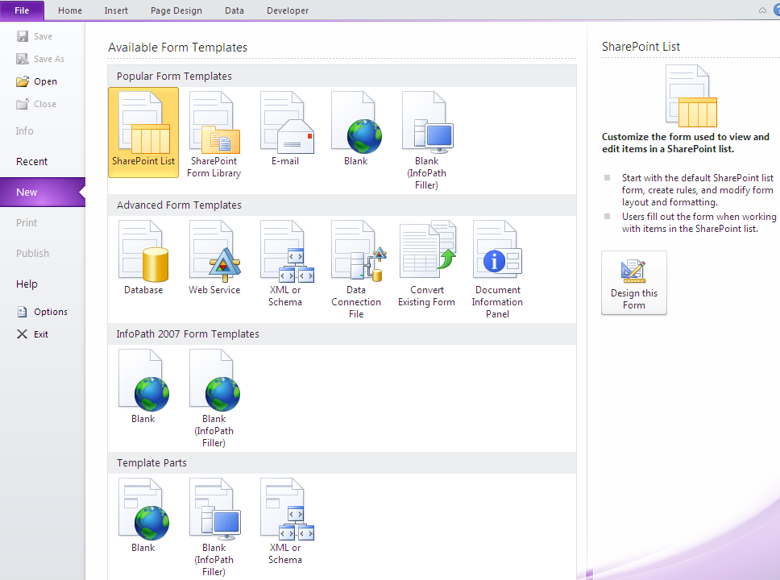
InfoPath Backstage
Pick a template to get started
Notes:
TheInfoPath Backstage shows all of the different types of form solutions you can create. You can start with a Blank form and later decide where you want to publish it or start with a template that will guide you towards publishing your forms solution to a specific type of location.

Slide 7
Agenda
Introducing InfoPath 2010
Form Designer Development Tools
Incorporating Form Logic
SharePoint List Forms
Form Library Forms
Data Connections to External Sources
Publishing Options

Slide 8
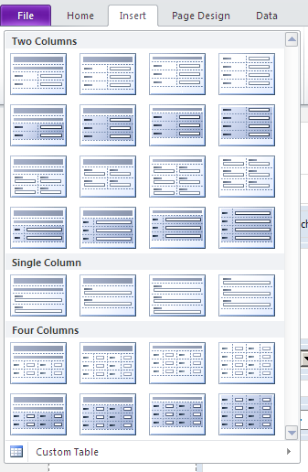
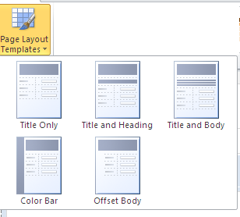
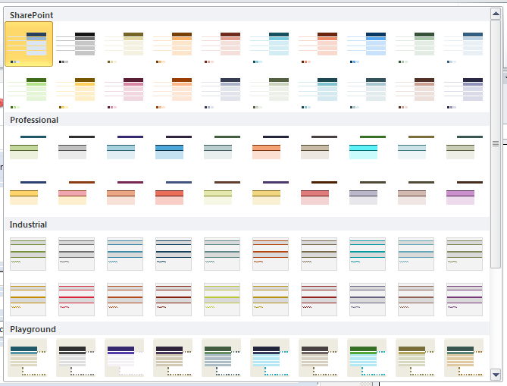
Easy Form Development Tools Table and Section Layouts, Themes
Table Layouts
Page Layouts
Themes
Notes:
To get started with form design, you can use the easy to use form development tools provided in the ribbon.
Start with using an existing pre-defined page Layout that comes close to what you envision the final form to be. Then use the Table Layouts within sections of the page to create various parts of the form. Finally, choose from a myriad of provided Themes to change the colors of your form.

Slide 9
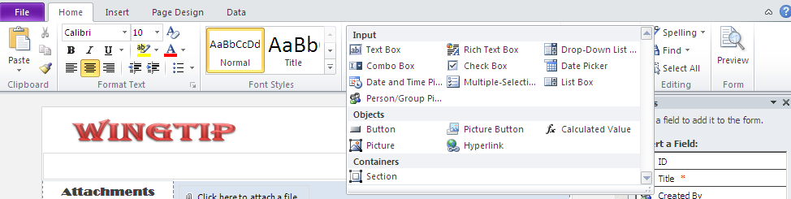
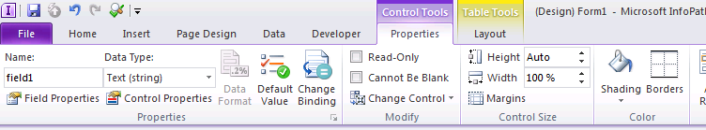
Easy Form Development Tools Formatting and Controls
A rich set of design tools:
MS Word like formatting
Variety of Form Controls
Notes:
Formatting of text in InfoPath is just like within Microsoft Word. Form designers will realize that their knowledge of text formatting in Word transfers over very well to InfoPath.
A large set of input controls are available for the designer. Controls such as text box, check box, date picker and more which are usually used by developers to create forms are available to create robust and interactive applications.

Slide 10
DEMO
A Lap Around InfoPath

Slide 11
Agenda
Introducing InfoPath 2010
Form Designer Development Tools
Incorporating Form Logic
SharePoint List Forms
Form Library Forms
Data Connections to External Sources
Publishing Options

Slide 12
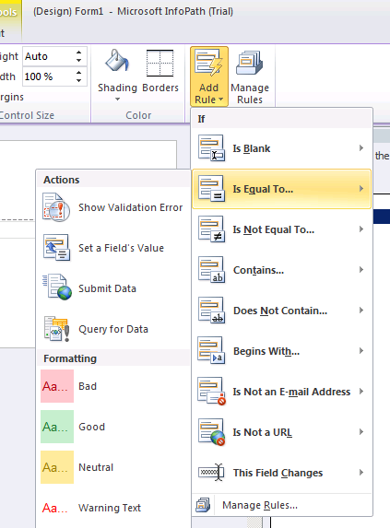
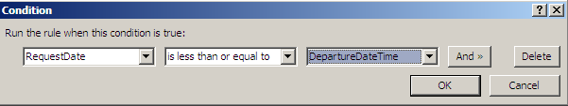
Powerful Rules for Forms Logic
Create Rules in Forms for:
Validation – Data Validation within controls
Formatting – Formatting of information displayed in controls
Action – Usually used on Buttons and Picture Buttons to execute an action
Notes:
Rules in InfoPath are like mini workflows. They can be attached to and execute on any control within the form. A rule is usually configured with certain conditions and multiple subsequent actions.
An Add Rule wizard exists in the ribbon to quickly create the most popular types of rules (shown in image on slide). If none of these will suffice for your need then clicking on Manage Rules button brings up the rules configuration task pane.
Three types of rules can be configured here:
Validation: Data validation is a necessity for many scenarios. A example of a validation rule would be to check if a field’s value is not equal to another field’s value and display an error if that’s the case.
Formatting: Formatting of control usually deals with changing the font or colors of a control based on certain criteria.
Action: Setting a field’s value, querying for data and submitting data are all different types of actions you can take when, for example, a button is clicked.

Slide 13
Agenda
Introducing InfoPath 2010
Form Designer Development Tools
Incorporating Form Logic
SharePoint List Forms
Form Library Forms
Data Connections to External Sources
Publishing Options

Slide 14
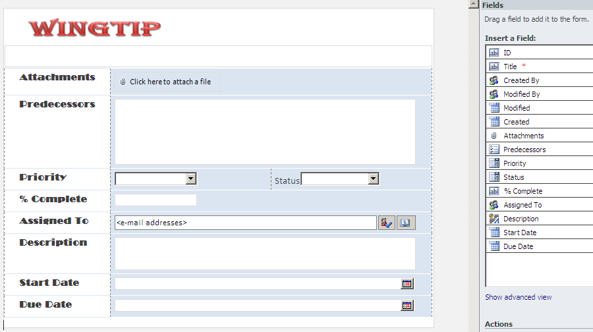
InfoPath List Form
Use the power of InfoPath to manage List Forms
Notes:
Work has been done in the InfoPath team to ensure that Information Workers get the experience they expect when editing forms using InfoPath. The InfoPath data source is hidden behind a ‘advanced view’ to hide the hierarchical nature of InfoPath data. The controls that you can use in InfoPath now also have parity with SharePoint.

Slide 15
DEMO
Modifying SharePoint Lists w\ InfoPath

Slide 16
Agenda
Introducing InfoPath 2010
Form Designer Development Tools
Incorporating Form Logic
SharePoint List Forms
Form Library Forms
Data Connections to External Sources
Publishing Options

Slide 17
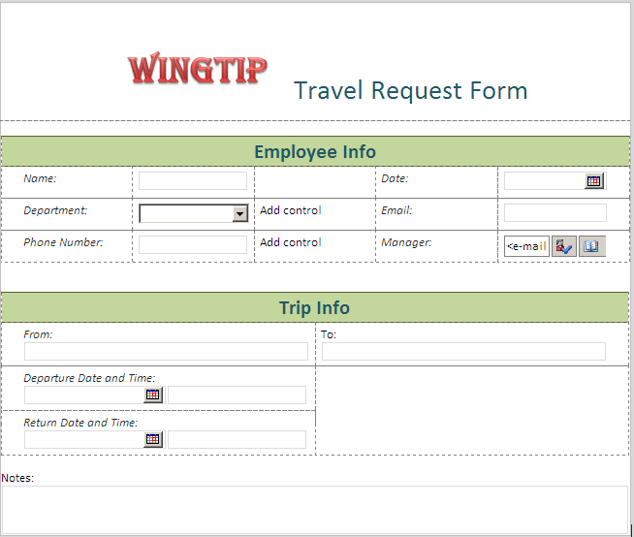
Form Library Forms
InfoPath Forms published to Form Library in SharePoint
Forms can be filled using InfoPath Filler or the browser
Notes:
The Form Library in SharePoint is enabled to host forms created in InfoPath. InfoPath publishes a form template, with a *.XSN extension, to a specified form library. End users can then visit this library and fill out forms using this template. The forms can get served either in the InfoPath client or the browser (this functionality requires SharePoint Enterprise CAL) depending on the settings set at the form library level. The resulting forms get saved with a *.XML extension.

Slide 18
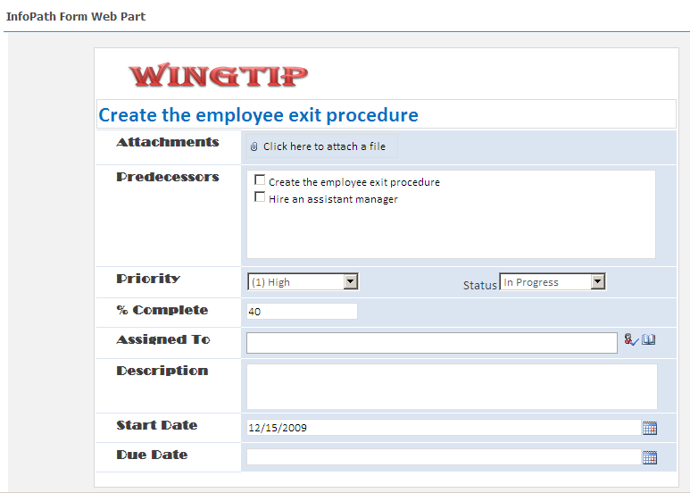
InfoPath Form Web Part
Show InfoPath forms within a Web Part
Create connections to other Web Parts
Notes:
InfoPath forms can be served standalone directly from a form library. In addition, you can present it in an InfoPath form Web Part. The advantage of presenting the form in the form Web Part is that you can use the Web Part connections interface to receive data or forms from another list or library.

Slide 19
DEMO
Form Library Forms

Slide 20
List Forms vs. Form Library Forms
List Forms
Flat Schemas
Data Stored in Lists
Offline Storage with SharePoint Workspace
Library Forms
Deep Schemas
Digital Signatures support
Sandboxed Solutions
Notes:
List Forms and Form Library forms both have their own place. It’s recommended to utilize list forms as your first choice unless there is a need for form library forms. Below is the breakdown of the qualities for each:
List Forms
All data stored directly in SharePoint Lists
Flat field schema
Take offline with SharePoint Workspace
Form Library Forms
*.XML file is primary storage
For advanced scenarios:
Supports nested and repeating schema
Supports digital signing
Supports sandboxed solutions

Slide 21
Agenda
Introducing InfoPath 2010
Form Designer Development Tools
Incorporating Form Logic
SharePoint List Forms
Form Library Forms
Data Connections to External Sources
Publishing Options

Slide 22
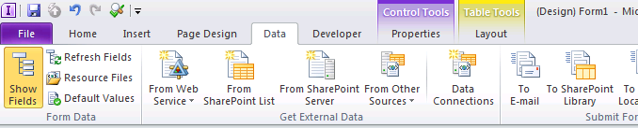
Data Connections to External Sources
Bring in data from a variety of sources:
Web Services
SharePoint List and Libraries
Databases
XML Files
Notes:
InfoPath excels in its capability to fetch data from external sources. Information can be fetched from a variety of places and incorporated within the form’s controls. Data can gathered when the form is loaded or it can be queried based upon an event or action taken by the user.

Slide 23
DEMO
Data Connections from Forms

Slide 24
Agenda
Introducing InfoPath 2010
Form Designer Development Tools
Incorporating Form Logic
SharePoint List Forms
Form Library Forms
Data Connections to External Sources
Publishing Options

Slide 25
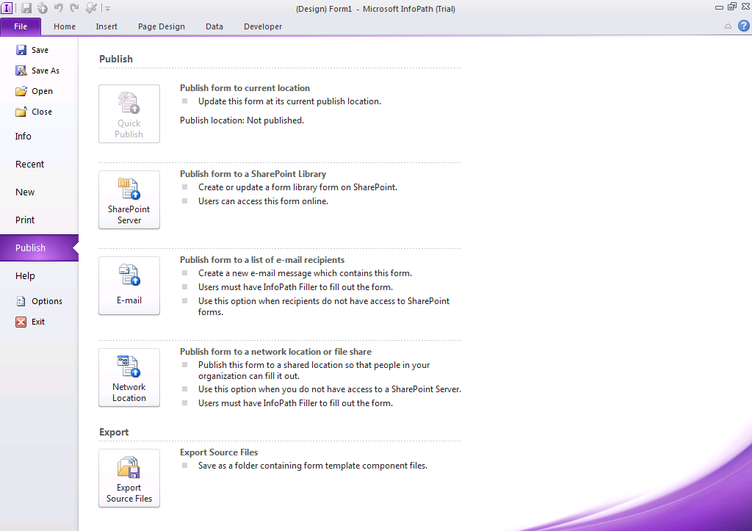
Publishing Options
Notes:
Forms can be published to a variety of locations where the users can then interact with them:
SharePoint Server: This is the recommended location for forms. Forms reside in form libraries on the SharePoint Server.
Email: Forms can be sent directly to end users’ inboxes with the caveat being that the user must have InfoPath installed on their system to fill out the form.
Network Location: Forms can simply be placed at a network from which users can fill them out.

Slide 26
Demo
Publishing Options

Slide 27
Summary
Introducing InfoPath 2010
Form Designer Development Tools
Incorporating Form Logic
SharePoint List Forms
Form Library Forms
Data Connections to External Sources
Publishing Options

